Slide 1
“CHATBOT USING PYTHON”

Slide 2
UNDER THE GUIDANCE OF:SWATI.S.KAGI
HARSHA(SW21AIM016)
MEGHANA(SW21AIM023)
REHANA BANU(SW21AIM031)
SADIYA FATIMA(SW21AIM032)
SHREYA GAWALI(SW21AIM044)
SIMRAN TABASSUM(SW21AIM046)

Slide 3
INTRODUCTION
Chatbot is an AI chatbot that uses natural language processing to create humanlike conversational dialogue. The language model can respond to questions.
Chatbots can automate tasks performed frequently and at specific times. This gives employees time to focus on more important tasks and prevents customers from waiting to receive responses.

Slide 4
IN OUR PROJECT WE USED
PYTHON
HTML (Hyper Text Markup Language)
CSS (Cascading Style Sheet)
JAVASCRIPT
JSON

Slide 5
PYTHON
Python is a object-oriented, high-level computer programming language often used to build websites and software, automate tasks, and conduct data analysis.

Slide 6
HTML
Hyper Text Markup Language
It is used to describe the structure of information on a web page
It is one of the standard markup language using which develop web pages or to create web pages using tags

Slide 7
BASIC HTML TAGS
Html (<html>…</html>)
Head tag (<head>…</head>)
Title tag (<title>…</title>)
Body tag (<body>…</body>)
Heading tag (<h1> … </h1>)
Image tag (<img>)
Divide tag (<div> … </div> )
Span tag (<span> … </span> )

Slide 8
CSS
CSS stands for Cascading Style Sheet
CSS is used to set the style in web pages that contain HTML elements.
CSS describes how HTML elements are to be displayed on screen.
CSS saves a lot of work. It can control the layout of multiple web pages all at once
It sets the background color, font size, font family,color…etc

Slide 9
JAVASCRIPT
JavaScript is a programming language which is also known as the scripting language for webpages
JavaScript is commonly used to dynamically modify HTML and CSS to update a user interface
JavaScript can run on a server to handle from submissions from users, data requests to other servers,even intract with databases….etc

Slide 10
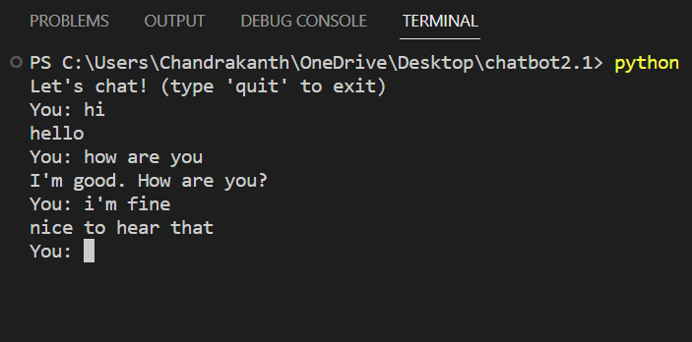
Before using (HTML, CSS, JAVASCRIPT)

Slide 11
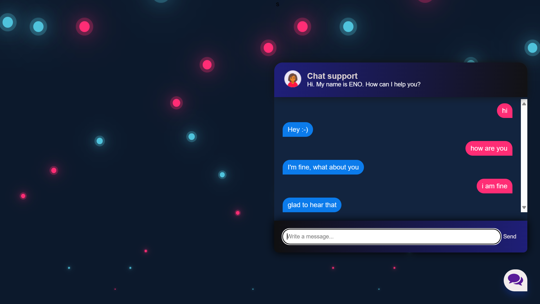
After using (HTML, CSS, JAVASCRIPT)

Slide 12
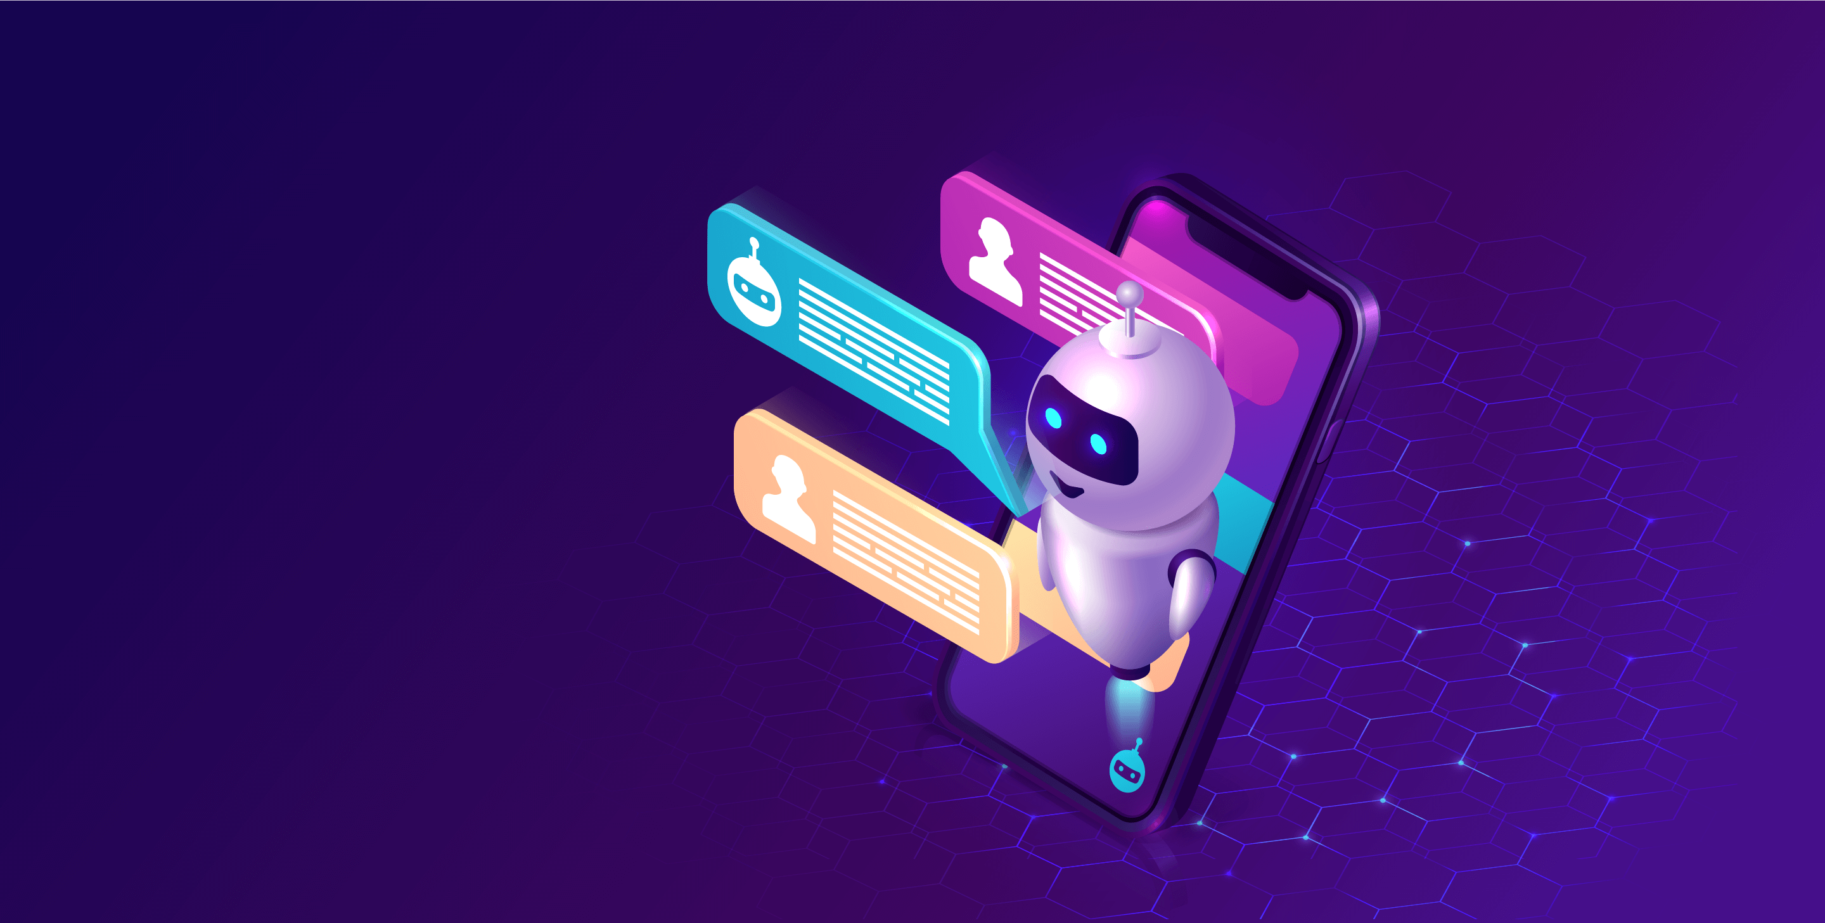
Html, CSS and Javascript together make up an essential website

Slide 13
CHATBOT
It is the most basic level, a chatbot is a computer program that simulates and processes human conversation (written and spoken), allowing humans to interact with digital devices as if they were communicating with a real person.

Slide 14
USES OF CHATBOT
Chatbots can automate tasks performed frequently at specific times. This gives employees time to focus on more important tasks and prevents customers from waiting to receive responses.

Slide 15
USES
Organizations looking to increase sales or service productivity may adopt chatbots for time savings and efficiency, as artificial intelligence (AI) chatbots can converse with users and answer recurring questions.

Slide 16
Thank you

